Slide 1
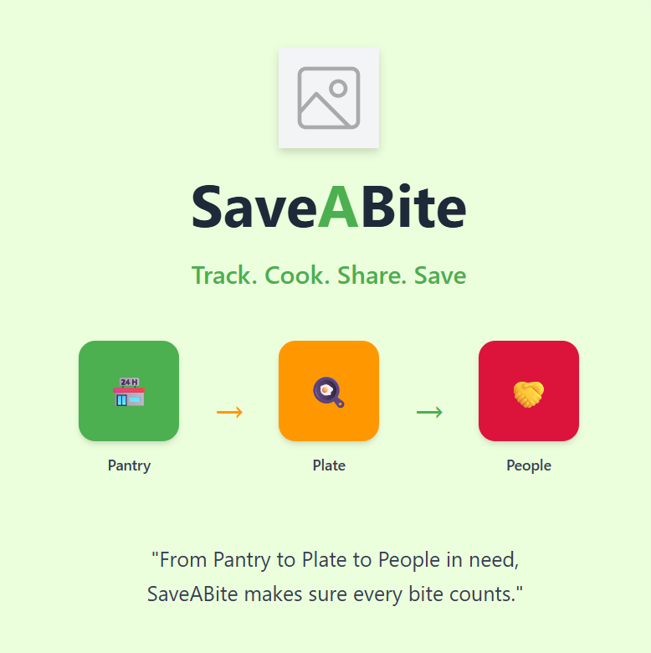
From Pantry to Plate to People in need, SaveABite makes sure every bite counts.

Slide 2
Problem Statement
Families & communities waste food on a daily basis. This is typically caused by forgetting to check expiration date & buying more than necessary. Wasted food is often disposed of in landfills, emitting methane gas, a factor that contributes to climate change.
Therefore, a smart yet easy and simple solution is needed for better food management and to reduce waste effectively.

Slide 3
Proposed Solution
SaveABite is a smart sustainability app that assists users in reducing food waste by tracking groceries, providing recipes to use the leftover or soon-to-expire ones, and allowing the donations to local NGOs, food banks, or soup kitchens.
It offers convenience, social responsibility and environmental awareness through gamification in the form of points, and leaderboards so that users can stay active and consequently save money, waste less and make the world a more sustainable and caring place.

Slide 4
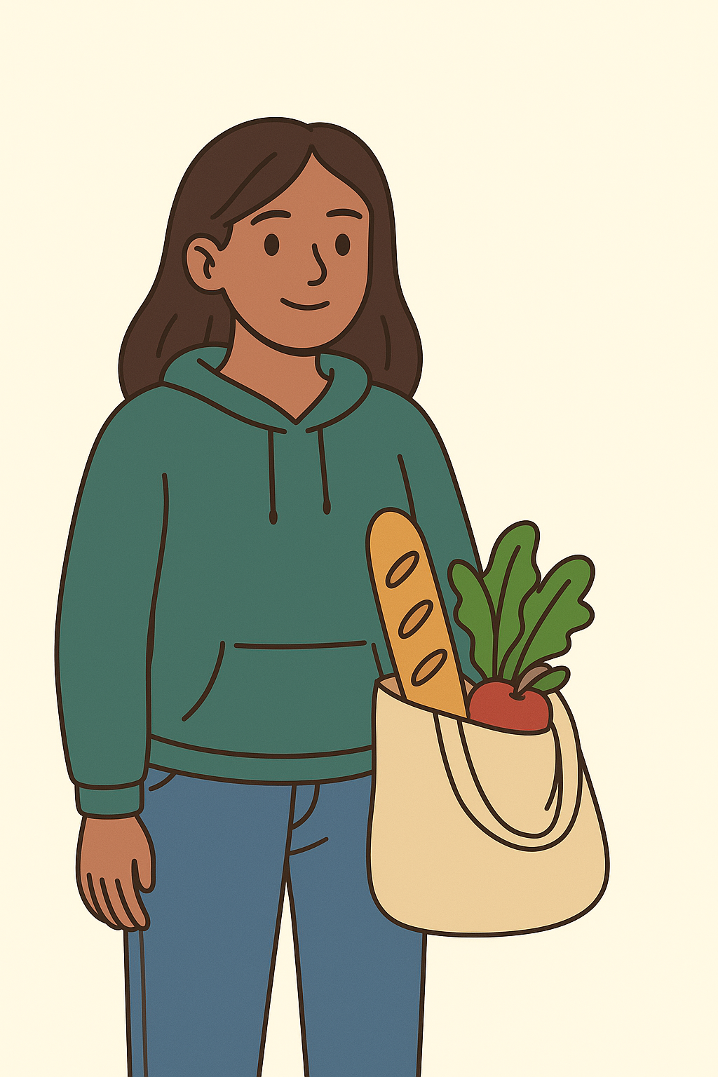
User Persona
Name: Issa Sharma
Age: 20
Occupation: College Student living in a shared flat
Goals: Save money, eat healthier, waste less food
Frustrations: Always forgetting expiry dates, throwing away half-used items, no idea where to donate leftovers
Behaviours: Shops weekly, cooks occasionally, uses mobile apps for budgeting

Slide 5
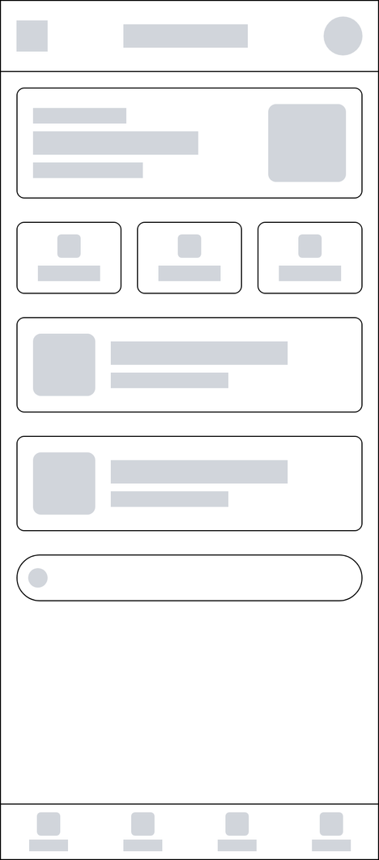
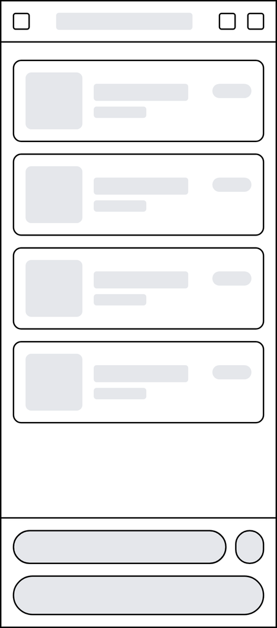
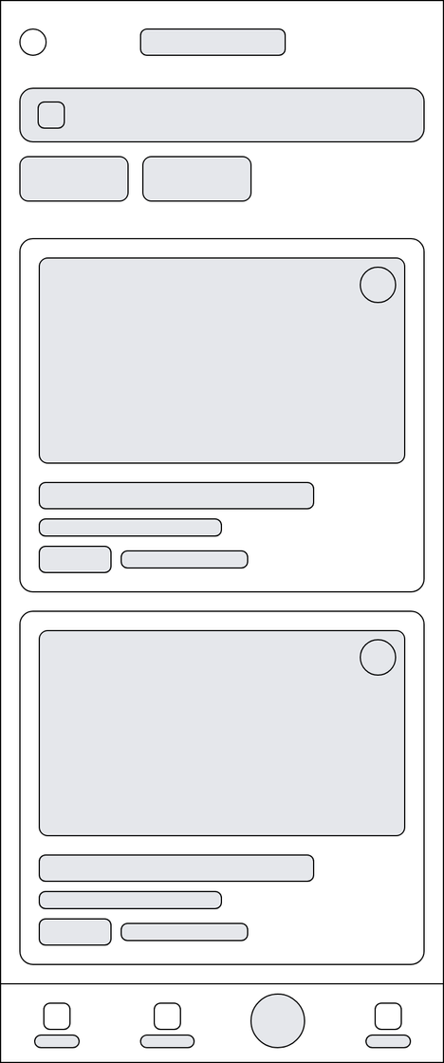
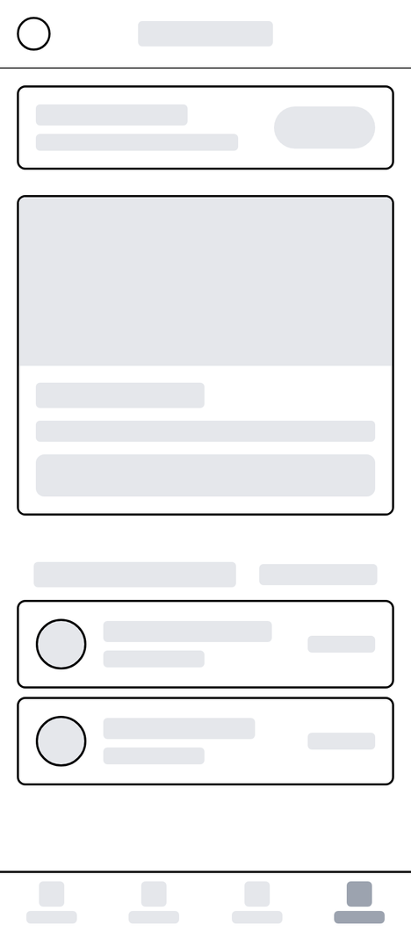
Low-Fidelity Wireframe

Slide 6
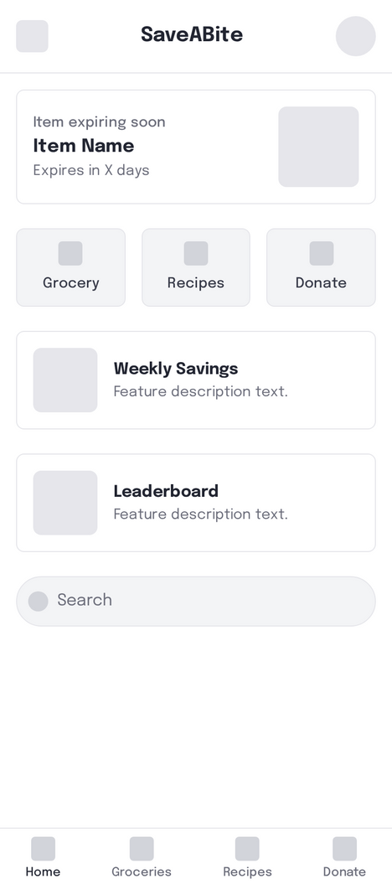
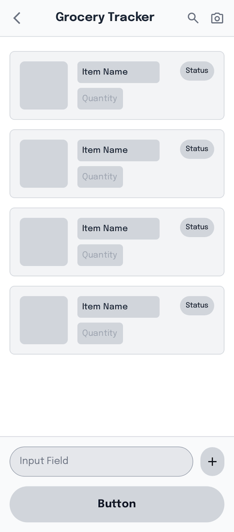
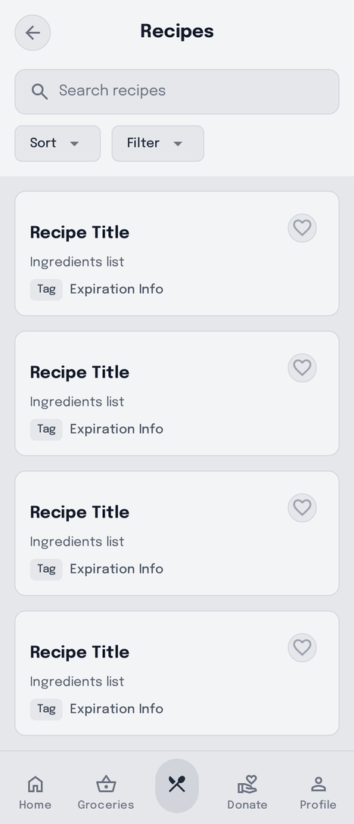
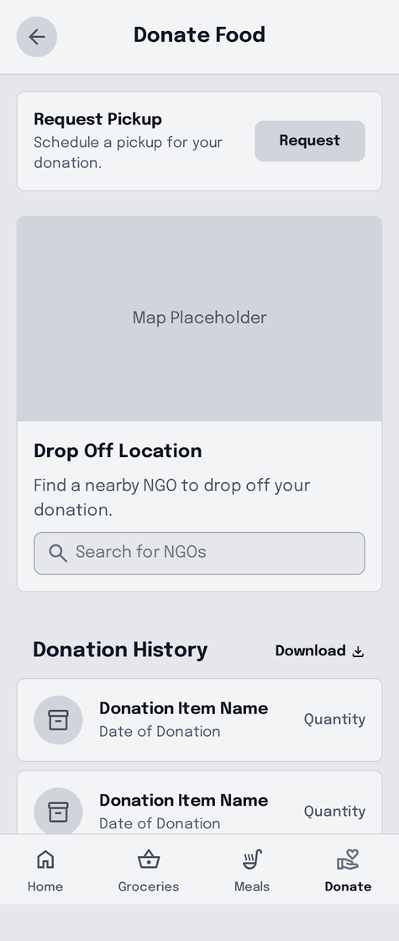
Mid-Fidelity Wireframe

Slide 7
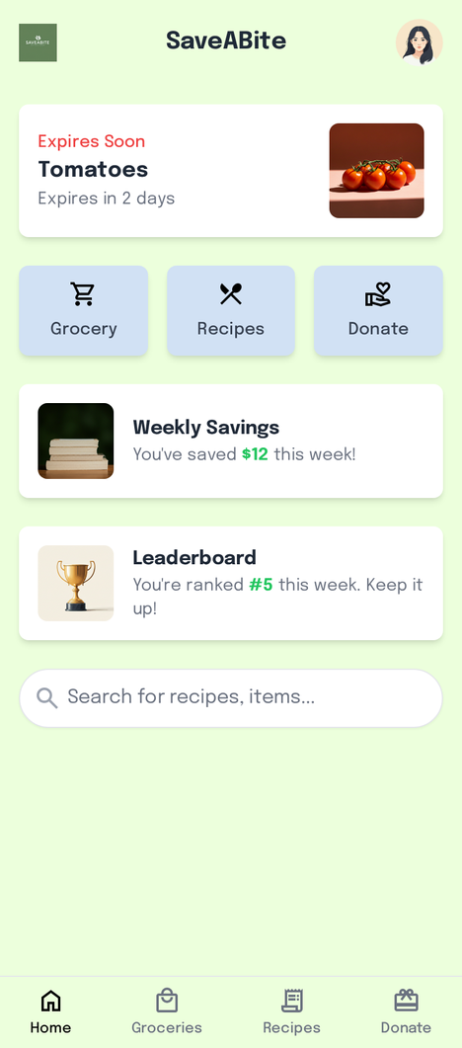
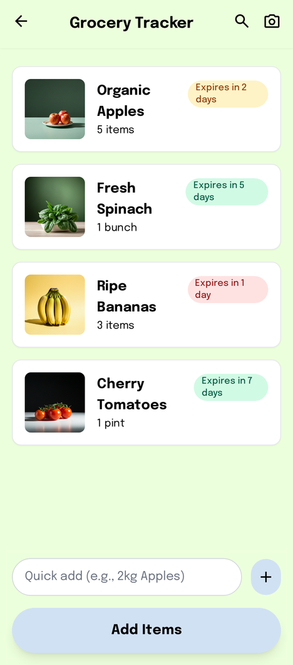
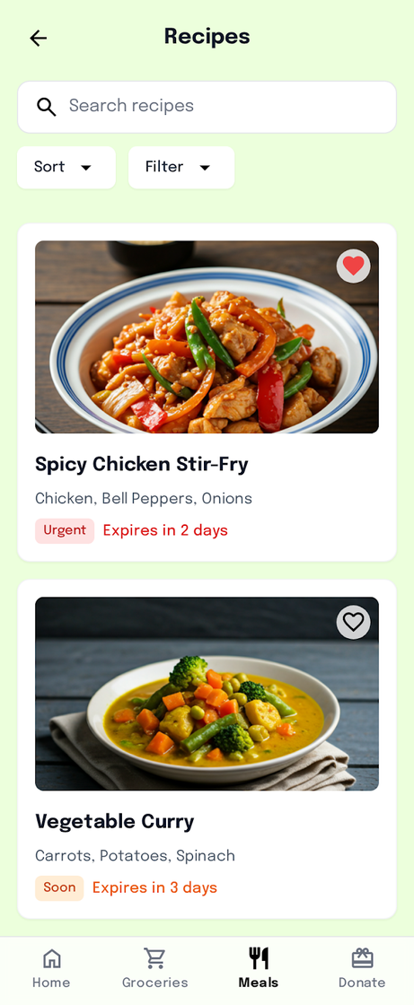
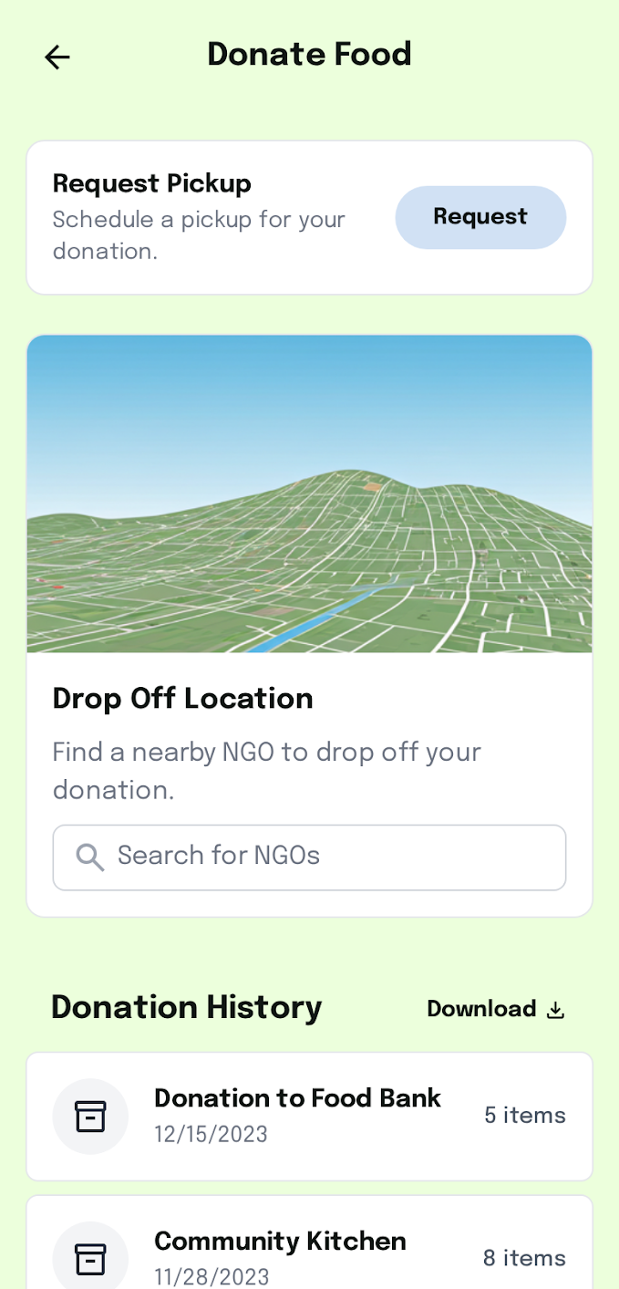
UI Mock-ups

Slide 8
Psychological Principles in Use
Miller's Law (Chunking)
Information is divided into digestible amounts (cards, tiles or modules).
Facilitates memorizing and retrieving information.
2.Jakob Law (Users Prefer Familiar Patterns).
The designs are based on the common UI principles (navigation bar, card design, search boxes).
This makes the learning curve much less as users are able to bring along expectations of other apps.
3.Hick Law (Minimizing Cognitive Load)
Screens have fewer options, eliminating decision fatigue.
Each piece of content is logically grouped (filters, navigation, and main content separated).

